Slide 1
Spatial Data Interoperability Demnostration Project (SIDP)
52nd OGC Technical Committee Meetings
United Nations
Carl Reed for Maurits
January 18, 2005

Slide 2



A Major Partnership

Slide 3
SIDP: Aims and Objectives
To add real value to the end user community and work with end user organisations in the sectors of:
  Emergency Management
  Insurance
  Utilities
Demonstrate the value of on-demand (interoperable) access to spatial information
Demonstrate that on-demand access is technically feasible
To develop the knowledge, skill base and commercial opportunities for the Australian Spatial Information Industry in the area of interoperability and open geospatial standards

Slide 4
SIDP: Aims and Objectives
To provide the foundation of a national interoperable spatial architecture that will lead to:
  Ongoing additions and enhancements
  Be of on going value to the government, industry and research communities
  Fuel further activities and initiatives to enable improved access and sharing of geospatial information
To identify institutional barriers & recommendations on how to overcome them

Slide 5
Audience
Customers (Users)
  Raise Awareness
  Capture Requirements
  Demonstrations
Information Providers (Content & Services)
  Raise Awareness
  Build Capacity
Implementers (Spatial Information Industry)
  Demonstrations
  Capacity Building

Slide 6
“What’s in it for me?”
Access for whole of government
  Fundamental data maintained by custodians (“point of truth”)
  Common Australia-wide SDI Architecture
    Notional Architecture is available for member access via the OGC members portal. (in OGC-A folder)
    Vetted and approved by ANZLIC.
Improved Community Service Delivery
  Access to more information
  Wider distribution of data sources
  Higher Quality Information Products
Supported by all major solution providers
  CadCorp, ESRI, Intergraph, Ionic, MapInfo, Oracle, etc
    (in alphabetical order)

Slide 7
What SIDP is not…
NOT a Technology Push
  Engaging with the user community early and often
  Address their real needs
NOT a duplication of past and existing effort
  SIDP aims to build upon existing initiatives, implementations and structures.
NOT a “cutting edge” technology development project
  Use SCOTS components:
    Relevant
    Real
    Robust
NOT about preaching how to use Spatial Information in Emergency Management

Slide 8
3 Demonstration Scenarios
Incident Notification
  Notification to infrastructure owner
  Analysis
  Planning for Response
  Co-ordination
Bush Fire
  Response form Emergency Management Coordination Center
  Deployment of resources
  Management of data
  Co-ordination
Risk Assessment
  Insurance Agency
  Recovery of emergency event
  Portfolio & asset mgt
  Spatial analysis

Slide 9
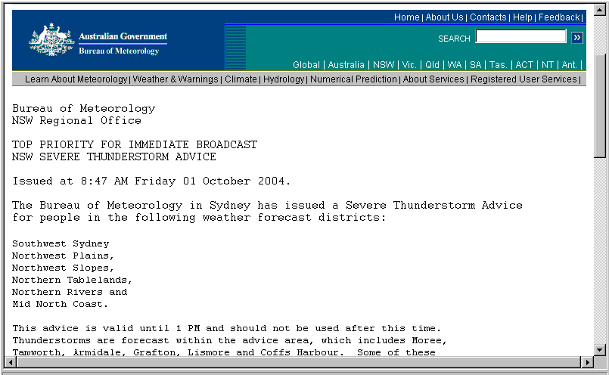
Insurance - Risk Management and Recovery
Event Initiation
Recovery Event Template
- Storm
Company operating procedures to be observed
Regulatory and statutory requirements
Content availability - internal and external

Slide 10

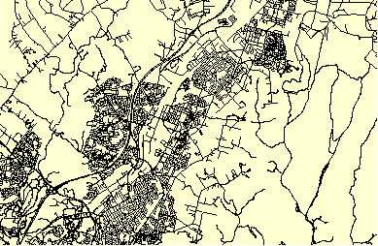
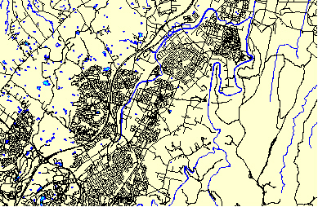
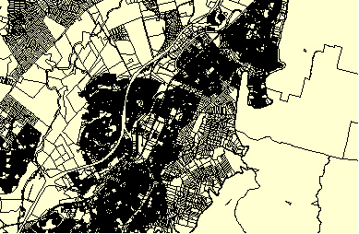
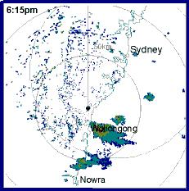

Insurance - Risk Management and Recovery
1. Initial Location – Storm Tracking
Services External
Topography
Cadastre
Storm -
Predicted Track
Services Internal
Policyholders
SMS Alert to policy holders at risk

Slide 11

Insurance - Risk Management and Recovery
2. Claims Location
Services External
BOM - High intensity storm areas
Flood areas
Field Office 2
Services Internal
Policyholders
Field Office 1
Claims Lodged
Field Offices

Slide 12
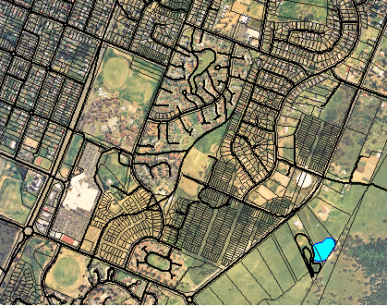
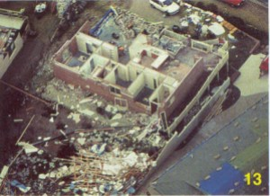


Insurance - Risk Management and Recovery
3. Response Analysis
Services External
Metropolitan Insurance Company
Campbelltown 2006 Storm
Total no. of claims 1100
Portfolio in area 7100
Buildings 2500
Content 2200
Commercial 600
Cars 1800
Av claim $5.7k
Running cost $6.3m
Estimated total $20.1m
Aerial Photography
Before
After
Services Internal
16:21 7 July 04
Policyholders
15:01 7 July 04
Claims Lodged
Assessors deployed
15:00 7 July 04
Claims Estimate

Slide 13

Insurance - Risk Management and Recovery
4. Claims Analysis
Services Internal
Claims not lodged by policyholders in high intensity zones
Metropolitan Insurance Company
Campbelltown 2006 Storm
Total no. of claims 1100
Portfolio in area 7100
Assessor average $6.2k
Assessor 1 $5.7k
Assessor 2 $15.8k
Assessor 2 $7.2k
Claims lodged outside of high intensity storm areas
Vehicle damage in areas with no hail damage to houses
Vehicle damage to cars from risk addresses outside of affected area
Assessor statistics

Slide 14
Insurance - Risk Management and Recovery
5. Notification
Internal MIC Advice:
High intensity area
Flood areas
Portfolio locations
Field offices
MIC Customer Advice:
Notification procedures details
Contact number: 1234 5678
Field office locations
Emergency service contact details
Data and maps published to secure server for assessors and senior management
OK
OK
Data published for public and media to public web site

